Slide 1



Knowledge is Collection of Dead Facts and Information
Knowing is Melting of Mind into the Unknown
Knowledge is Someone Else's Knowing
Knowing is Your Knowledge
[ ZENTILL]

Slide 2
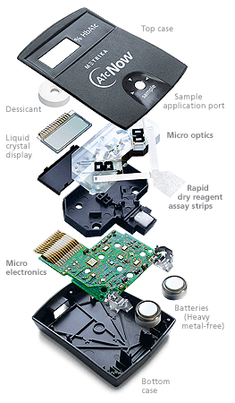

7-08-2015
Workshop On
Design of Digital Controllers in FPGA using Matlab System Generator Toolbox – Hands On
Starting Time 8:30 AM
M.Senthil Kumaran
S. VIjayenthiran
Finishing Time – We Don’t Know

Slide 3



About the Lecture
கற்றில னாயினுங் கேட்க அஃதொருவற் கொற்கத்தின் ஊற்றாந் துணை
தாமின் புறுவது உலகின் புறக்கண்டு
மாடல மற்றை யவை
தாமின் புறுவது உலகின் புறக்கண்டு
மாடல மற்றை யவை
Making Knowing Abundant in India

Slide 4
About the Lecture
தாமின் புறுவது உலகின் புறக்கண்டு
காமுறுவர் கற்றறிந் தார்.
தாமின் புறுவது உலகின் புறக்கண்டு
மாடல மற்றை யவை
தாமின் புறுவது உலகின் புறக்கண்டு
மாடல மற்றை யவை
Making Knowing Abundant in India

Slide 5
About the Lecture
It is in the Desire to share and not to teach…….
Senthil Kumaran Mahadevan
So nothing here is right or wrong every thing is wonderful
ZENTILL
Have a nice Day…….

Slide 6

Salute
TEACHERS
Give even your victory to the students and take their failures as yours
To a Real teacher

Slide 7

Salute
Workshop On
Design of Digital Controllers in FPGA using Matlab System Generator Toolbox – Hands On
Starting Time 8:30 AM
M.Senthil Kumaran
VIJAYENDERAN
Sacrifice →
Finishing Time – We Don’t Know
To a Real teacher

Slide 8
Special Thanks …………..
To my Professor
Dr. Ranganath Muthu
&
Senthil Kumaran Mahadevan
Ms. Anitha Roseline
Who where a force behind me to make this Workshop Happen

Slide 9
Thanks …………..
To my Students
S. Vijayenthiran (CTS)
S. Adithya BE(IV)
J.B. Mervin (Esab)
Senthil Kumaran Mahadevan
For encouraging me
&
For Preparing the entire hardware setup for this workshop

Slide 10



Instructions
An Alarm Indicates a New Topic
You will not be provided with Lunch if you want to go home early
If you are ready to invest your Time hear we give you very high Interest

Slide 11
A Quick Understanding of VHDL

Slide 12


Coding a controller & FPGA
Microcontroller
Codes on the Architecture
FPGA
Codes for the Architecture

Slide 13
Coding Methods in FPGA
Behavioral Architecture
{Single unit}
Non modular approach
Structural Architecture
{Interconnected unit}
Modular approach

Slide 14
Before we Code…………… Keywords
File types
*.VHDL file
*.Bit file
*.Mcs file
*.Ucf file
Coding
Entity
Architecture
Process
Xilinx
Synthesize
Implement design
Generate programming file

Slide 15
Behavioral Coding
VHDL Coding
AND Gate
JK Flip Flop
BCD – 7 Segment Converter

Slide 16
Behavioral…………… Coding
VHDL- LANGUAGE SYNTAX
Coding syntax of VHDL file
< include the library files >
entity <entity name> is
<Define the I/O Ports >
end <entity name>;
architecture Behavioral of <entity name> is
<Define or declare the intermediate signals>
begin
<VHDL Coding >;
process
< VHDL Signal Sensitive Coding >;
end process;
end Behavioral;

Slide 17
Behavioral…………… Coding
UCF-PORT ASSIGNMENT SYNTAX
Coding syntax of UCF file
NET “<Port Variable Name>” LOC= “FPGA Pin Number”

Slide 18
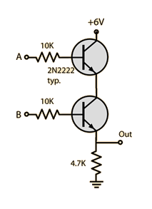
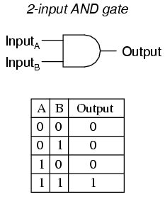
Behavioral…………… Coding
AND . GATE
library IEEE;
use IEEE.STD_LOGIC_1164.ALL;
entity And_Gate is
Port ( In1 : in STD_LOGIC;
In2 : in STD_LOGIC;
Out1 : out STD_LOGIC);
end And_Gate;
architecture Behavioral of And_Gate is
begin
Out1 <= In1 and In2;
end Behavioral;

Slide 19
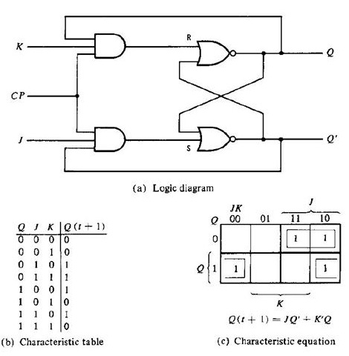
Behavioral…………… Coding
JK FLIPFLOP
entity JKFF is
Port (J,K,CLK:in bit; Q,QN:out bit);
end JKFF;
architecture JKFF1 of JKFF is
signal Qint:bit;
begin
Q<=Qint;
QN<=not Qint;
process(CLK)
begin
if CLK' event and CLK='0' then
Qint<=(J and not Qint) or (not K and Qint);
end if;
end process;
end JKFF1;

Slide 20
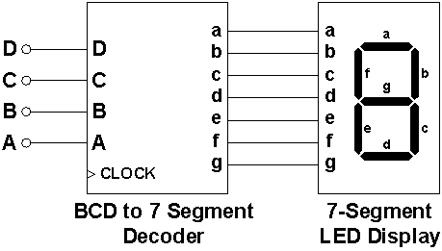
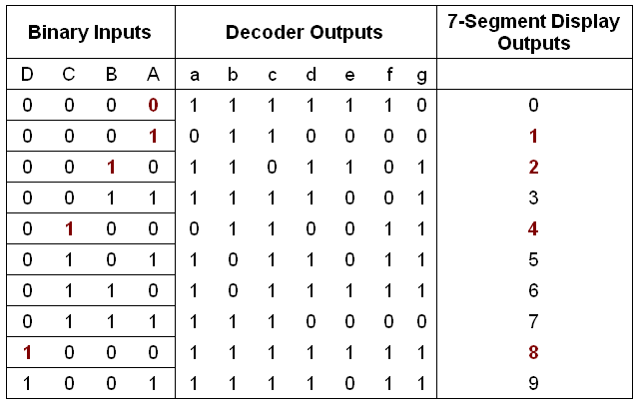
Behavioral…………… Coding
BCD – 7SEGMENT
entity FirstDemo is
Port ( switches : in STD_LOGIC_VECTOR (3 downto 0);
sevenseg : out STD_LOGIC_VECTOR (6 downto 0);
anode : out STD_LOGIC_VECTOR (3 downto 0));
end FirstDemo;
architecture Behavioral of FirstDemo is
begin
with switches select
sevenseg <=
"1000000" when "0000" ,
"1111001" when "0001" ,
"0100100" when "0010" ,
"0110000" when "0011" ,
"0011001" when "0100" ,
"0010010" when "0101" ,
"0000010" when "0110" ,
"1111000" when "0111" ,
"0000000" when "1000" ,
"0010000" when "1001" ,
"0010000" when others;
anode <= "0110";
end Behavioral;
NET "anode<0>" LOC = "F17";

Slide 21
Coding
VHDL Coding
AND Gate
JK Flip Flop
BCD – 7 Segment Converter
Ends ……..………

Slide 22

Coding – Through Model based approach
MATLAB- Xilinx interface
System Generator Tool box

Slide 23


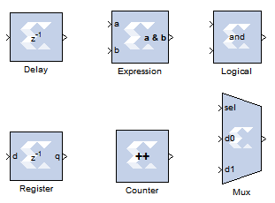

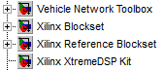
Interfacing Matlab and Xilinx Softwares

Slide 24
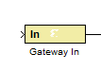
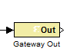
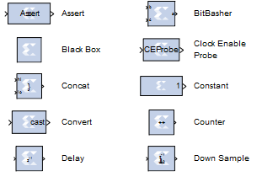
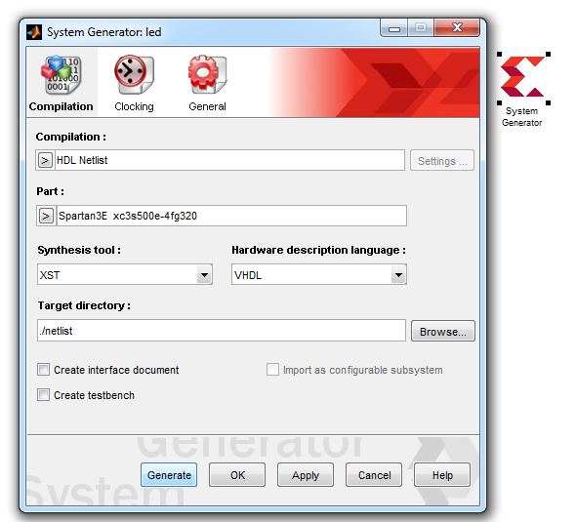
MATLAB - Xilinx Interface
Before we start Some ………
Xilinx tool box in MATLAB
UCF_Equivalent
System generator setting
Identify the FPGA& its hardware details
Generate the VHDL file

Slide 25
Model based design using MATLAB/System Generator Toolbox for Xilinx FPGAs
Control algorithm development in MATLAB -Xilinx tool box
Control Algorithm Developed with Xilinx tool box
Circuit inside the FPGA
FPGA
FPGA Pins
FPGA Pins

Slide 26
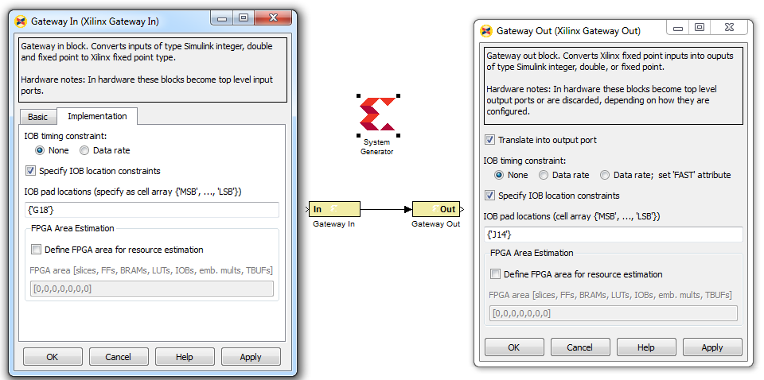

Lighting an LED with a switch MATLAB - Xilinx Interface
1
Identify the FPGA& its hardware details
Generate the VHDL file

Slide 27
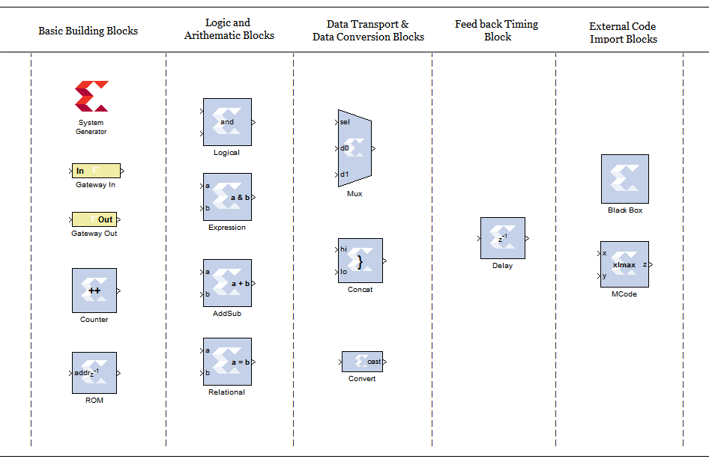
Basic Building Blocks MATLAB - Xilinx Interface

Slide 28
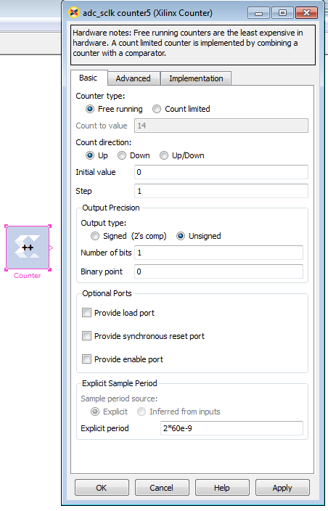
Component - Counter
Counter Parameters Setting MATLAB - Xilinx Interface
Conditions for setting counter time period
Time period of the Counter
= Integer
Time period of the System Clock

Slide 29

Knowledge becomes Wisdom only after it has been put to practical use

Slide 30
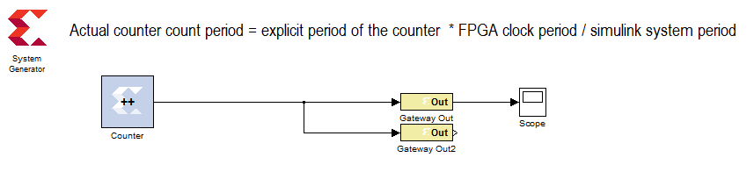
Pulse Generator
MATLAB - Xilinx Interface – Small problem
2
Let us try - Designing a Square wave frequency generator of 25Hz.
Idea- Use a one bit counter that counts at the required time.
Please Check it with the DSO on your table.

Slide 31
Pulse Generator
MATLAB - Xilinx Interface – Small problem
ON
ON
OFF
OFF
0.02 s
0.04 s
Conditions for setting counter time period
Time period of the Counter [0.02 s]
= Integer [1000000]
Time period of the System Clock [ 20 ns]

Slide 32
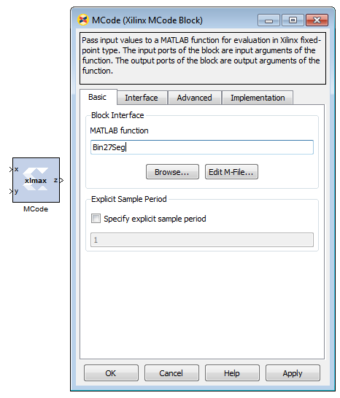
Component – M Code
M code Parameters Setting MATLAB - Xilinx Interface
M Code Parameter
File Name = XXXX .m
Note: File should be present in the folder where Matlab- Xilinx file is present

Slide 33
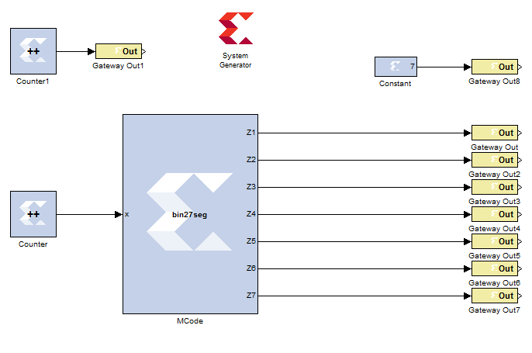
Counter-7Segment -interface MATLAB - Xilinx Interface – Small problem
3
9
0
10s

Slide 34
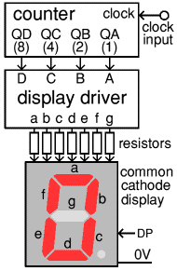
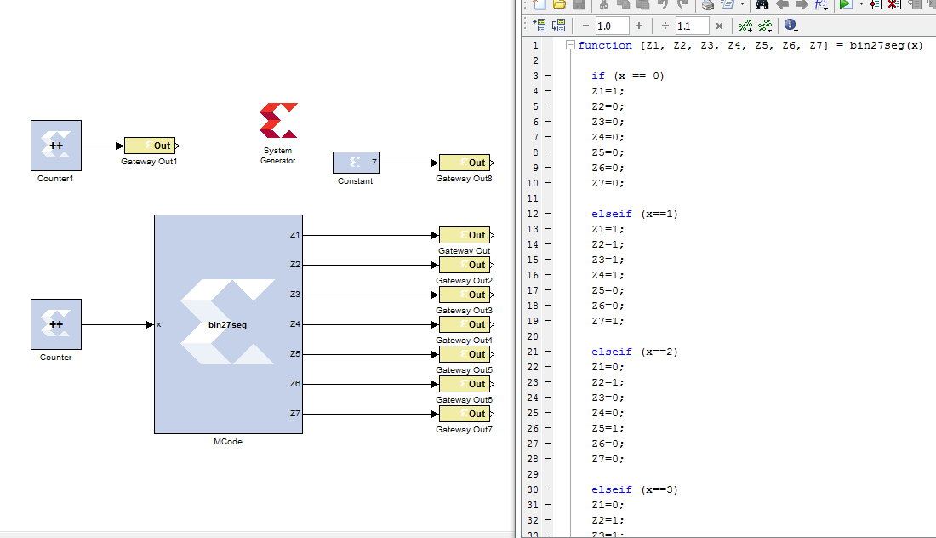
Counter-7Segment -interface MATLAB - Xilinx Interface – Small problem

Slide 35
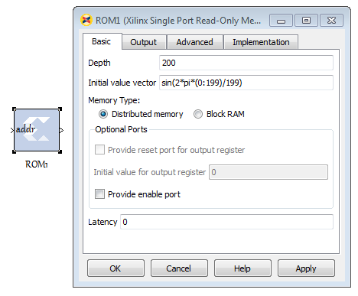
Component – ROM
ROM Parameters Setting MATLAB - Xilinx Interface
ROM Parameter
Depth = Number of data’s to be Stored
Vector values = Values to be stored
Note: For the specified Index [ Address] passed at the input, the ROM block delivers the value stored at that specified location

Slide 36
4
PWM Signal Generator for converters
MATLAB - Xilinx Interface – Small problem
Can we try
Design a PWM signal generator which creates a saw tooth wave of 4KHz internally and compares it with a sine signal of 50Hz internally to produce PWM pulses for a single phase inverter.
Please Check it with the DSO on your table.

Slide 37
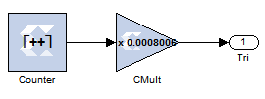
PWM Signal Generator
Triangular wave – 4 kHz
Choose Explicit period as an integer multiple of system clock frequency
Low Explicit period -----> High Resolution
High Explicit period -----> Low Resolution
Explicit period = 10* 20e-9 = 20e-8
Time period of Saw tooth = Count Value * Explicit period
Count Value
Count Value = 0.25ms / 20e-8
Explicit Period of counter
0
Count Value = 1250
0.25ms
Time Period of saw tooth
1
0
0.25ms
Normalizing to 1
1
__________________
Time Period of saw tooth
count value

Slide 38
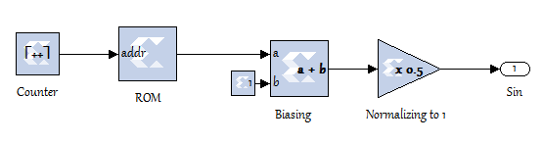
PWM Signal Generator
Sinusoidal wave – 50 Hz
Explicit Period of counter
Choose Explicit period as an integer multiple of system clock frequency
Low Explicit period -----> High Resolution
High Explicit period -----> Low Resolution
Explicit period = 5000*20e-9
Time period of Sin wave = Count Value * Explicit period
1
Count Value = 0.02 / 1e-04
Count Value
Count Value = 200
0
0.02s
-1
2
0.02s
Time Period of sin wave
1
Time Period of saw tooth
0
0

Slide 39
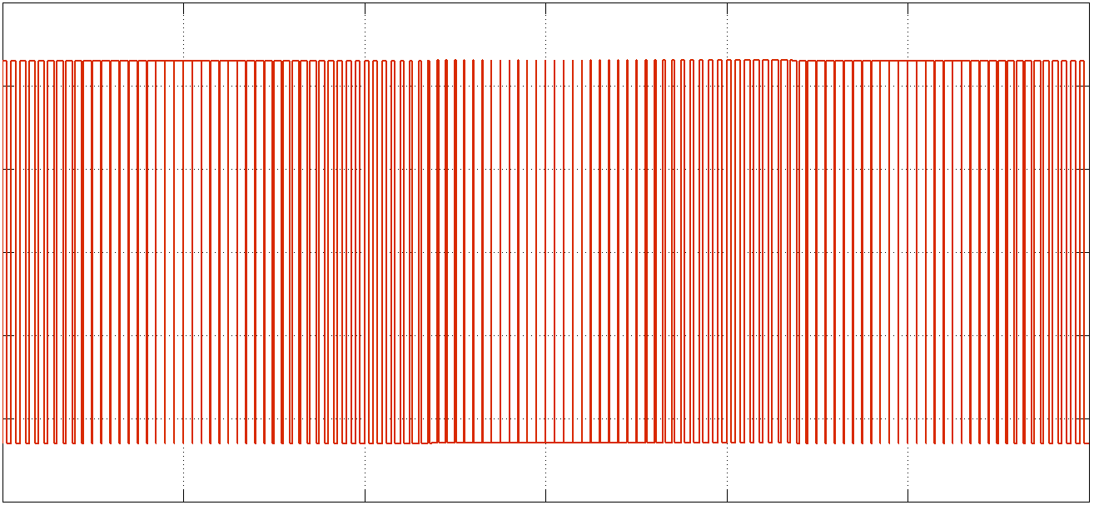
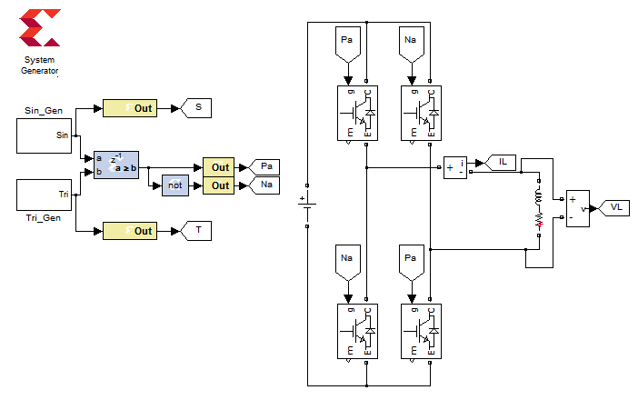
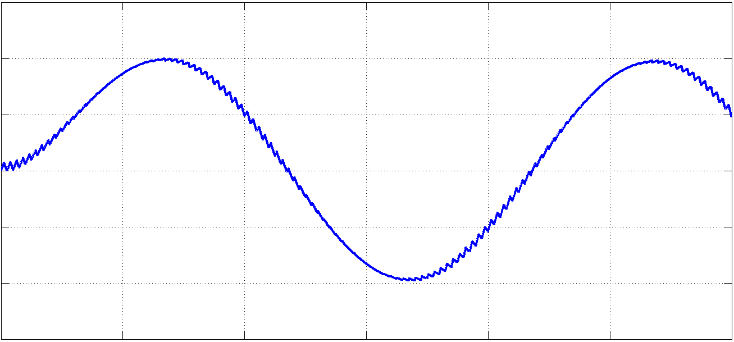
PWM Signal Generator
With Single phase inverter

Slide 40


You cannot Swim Without Jumping into waters
First Jump, Swimming Comes automatically
- Zentill [ ]

Slide 41
Data Acquisition MATLAB - Xilinx Interface
Digital Data Acquisition
Speed Encoder Data Acquisition
Analog Data Acquisition
Analog Voltage Signal Acquisition
Using PMOD AD2 – 12 Bit ADC Module

Slide 42
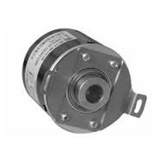
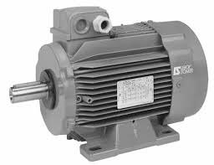
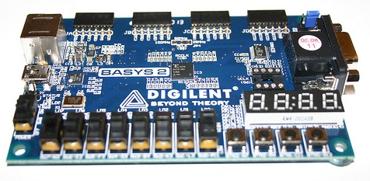
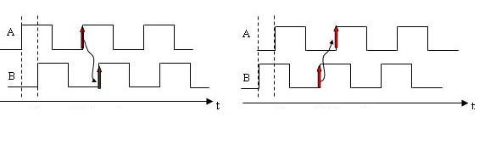

Speed Measurement Using
Encoder Unit
MATLAB - Xilinx Interface – Very Small problem
5
Acquired Digital Signals [ A,B,Z,~Z]
3 Phase Induction Motor
FPGA Kit
Encoder Unit
~Z
Z
B
A
Supply
Mechanical Linkage
Ground
Forward
Reverse

Slide 43
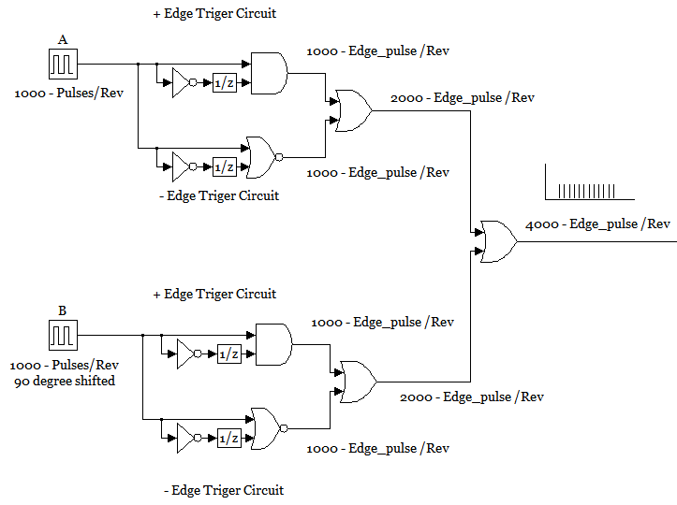
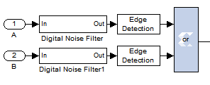
Understanding the Encoder Signals – And utilizing the Maximum PPR
Signals of Encoder
Signals | Meaning
A | 1000 Pulse/Rev
B | 90⁰ ⁻ Shifted - 1000 Pulse/Rev
Z | 1 Pulse /Rev
~Z | ~(Not) of Z
Forward
Reverse
Encoder Unit
~Z
Z
B
A
Supply

Slide 44
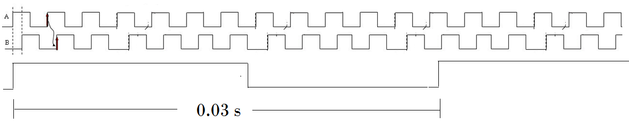
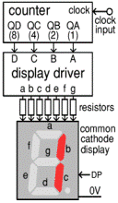
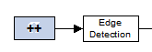
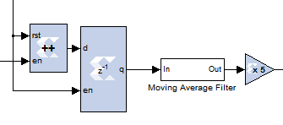
+ , - Edge detect
OR
+ , - Edge detect
+ Edge detect
Scan reset Edge pulses
4000 Edge pulses / Rev→ Signal
Scan Interval
Enable
Counter
4000 Edge Pulse/Rev → Signal
Buffer
?
Reset
Scan Reset Edge Pulses
?

Slide 45
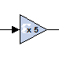
Multiplication Factor for RPM Conversion
?
Let scan period = 0.003 sec
Output of the Buffer [X] = Pulse / 0.003 sec
Encoder Pulse / Revolution [ Y ] = 4000
X / Y = Revolution / 0.003 sec
(X / Y )* (1/0.003)= Revolution / sec
(X / Y )* (1/0.003) *60= Revolution / min (RPM)
(X /4000)* (1/0.003) *60= Revolution / min (RPM)
X*5= Revolution / min (RPM)
Buffer Output
Speed in RPM

Slide 46
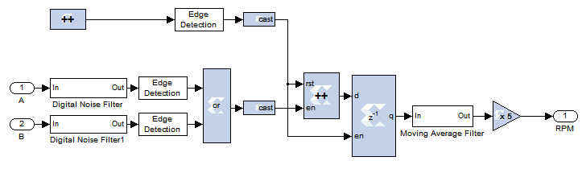
Complete Matlab – System generator Xilinx File
For Speed Sensing using Encoder unit
Sample period = Inferred from Inputs
Number of Bit = 12 ( a high count value)
Explicit period 0.0015 s
Number of Bit = 1
Error - in page to explain X 5

Slide 47
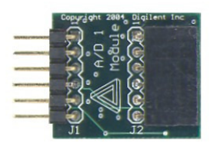
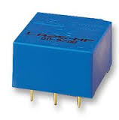
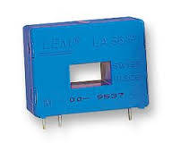
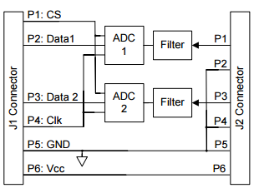
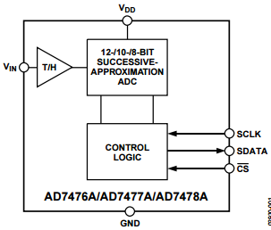
Voltage Measurement
Using PMOD AD2 Unit
6
Signals to be generated by FPGA to receive data from ADC
[ CS , Clk ]
PMOD AD1 Unit
Sensor
FPGA Kit
P1
Voltage Signal
Voltage Sensor
P2
P3
P1
P4
Current Signal
Current Sensor
P5
P6
P3
ADC = AD7478A
PMOD AD1 contains two 12 bit ADCs inside

Slide 48
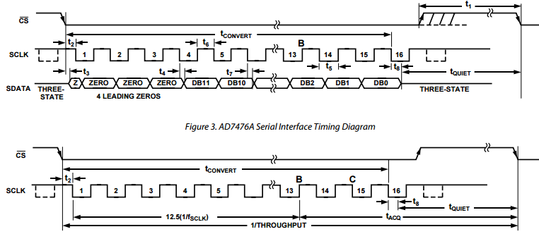
Timing Diagram of AD7478A

Slide 49
AD7478A – Data Acquisition Process
A low CS signal initiates the data transfer and conversion process when SCLK is in tri state.
During the fourth SCLK cycle, the MSB of the 12-bit data (D 11) is provided at the PMOD port of the FPGA.
The remaining 11 bits are provided at the rate of one bit per clock cycle.
At the end of the 15th cycle, the LSB (D 0) will be clocked out.
Hence, during the 16th cycle, the SCLK is made deliberately high to force the SDATA line to the “tri-state” again.
Between any two acquisition the minimum time that the SCLK should be in tri state is 50ns. (ie) T_{quiet} = 50ns

Slide 50
Rate of Conversion - Calculation
So
Time for 1 Conversion cycle = (1/2 SCLK) + (15 * SCLK) + (1 SCLK) + tQuite
= 120 ns + (15 * 240 ns) + 240 ns + 360 ns
= 4320 ns
No. of times an ADC can Sample a 50 Hz signal = 0.02 s / 4320 ns = 4629 samples

Slide 51
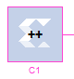
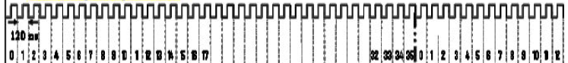
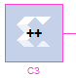
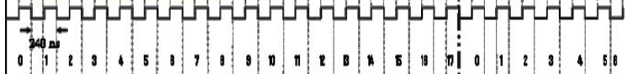
Procedure to achieve CS and SCLK
Design two clock pulses of period 120 ns (Base CLK) and 240 ns (SCLK)
Explicit period 60ns
Number of Bit = 1
Explicit period 120ns
Number of Bit = 1
= 120 ns + (15 * 240 ns) + 240 ns + 360 ns = 4320 ns = (1 Conversion Cycle)
No of Base CLK in 1 Conversion Cycle = 4320/120 = 36
No of SCLK in 1 Conversion Cycle = 4320/240 = 18

Slide 52
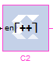
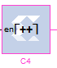
Procedure to achieve CS and SCLK
…… Continued
Design a counter C2 that counts the Base CLK till one conversion cycle =(0–35)
Count Value = 35
0
Explicit period = inferred from inputs
Number of Bit = 6
Count limited to 35
36 * 120ns
Design a counter C4 that counts the SCLK till one conversion cycle =(0–17)
Count Value = 17
0
Explicit period = inferred from inputs
Number of Bit = 5
Count limited to 17
18 * 240ns

Slide 53


Procedure to achieve CS and SCLK
…… Continued
CS _ Logic
SCLK _ Logic

Slide 54


System generator model for PMOD AD1 CS and SCLK
Signal generation

Slide 55

System generator model for PMOD AD1 CS and SCLK
Signal generation

Slide 56


Receiving Data from PMOD AD1 Unit
Most significant Word first
Unsigned
Number of Bits = 3 ( Zero Junk ) + 15 (Data)

Slide 57

Final PMOD AD1 Module Data acquisition File

Slide 58

Check You PMOD AD1 Interface Module

Slide 59


To Express is impossible
but
To make it possible is Teaching
- Zentill [ ]

Slide 60


Speed Control OF BLDC Motor
Using ESC Unit
MATLAB - Xilinx Interface – Very Small problem
7
ESC Unit
BLDC Motor
FPGA Kit
Control Signal
W
R
Supply
Not used
B
3 Phase Power Signals
Ground

Slide 61
Initialization of ESC Unit – Hints from datasheet
Generate your desired pulse between 700us to 2000us using the press button & 7 Segment modules provided to you
ON
ON
Control Signal
1st
2 Sec
OFF
OFF
2000us
2000us
0.02 s
0.02 s
Supply
Not used
ON
ON
2 ^{nd}
2 Sec
OFF
OFF
700us
700us
0.02 s
0.02 s
Ground
After
4 Sec

Slide 62
How to Generate timing pulses
Count Value
Count Value = 19999
Number of bits =15
Explicit period = 1e-6 s
0
Each step is 1 us
0.02 s
Time Period of saw tooth
Count Value = 19999
2000
0
Similarly do it for 700 us Pulse
&
Your speed control signal
0.02 s
Time Period of saw tooth
2000 us
Ist initialization Signal for 2 seconds to the ESC

Slide 63

How to Sequence the pulses in Time for
Initialization
A_2 - Counter Setting
Explicit period = 2s
Number of Bits = 1
Free Running Counter
B_4 - Counter Setting
Explicit period = 4s
Number of Bits = 1
Free Running Counter
NOR_GATE TT
A_2 | B_4 | Q
0 | 0 | 1
0 | 1 | 0
1 | 0 | 0
1 | 1 | 0
Counter A_2 - Output
Pulse Sequencing Decoder TT
2s
hi | lo | Q
0 | 0 | Pass your generated pulse
0 | 1 | 700 us pulse
1 | 0 | Don’t care state
1 | 1 | 2000 us pulse
Counter B_4 - Output
4s
Nor Gate Output
Time

Slide 64


Establishing the control Signal for ESC
Pulse Sequencing Decoder TT
hi | lo | Q
0 | 0 | Pass your generated pulse
0 | 1 | 700 us pulse
1 | 0 | Don’t care state
1 | 1 | 2000 us pulse
Pulse Sequencing Multiplexer Unit
Initialization Signals 2000 us
&
Initialization Signals 700 us
Control Signal to ESC
Given Press Button Input Unit
User Generated Pulse width signal

Slide 65
Initialization and Control of ESC Unit to drive BLDC under various speed
Generate your desired pulse between 700us to 2000us using the press button & 7 Segment modules provided to you
ON
ON
Control Signal
1st
2 Sec
OFF
OFF
2000us
2000us
0.02 s
0.02 s
Supply
Not used
ON
ON
2 ^{nd}
2 Sec
OFF
OFF
700us
700us
0.02 s
0.02 s
Ground
After
4 Sec

Slide 66


Demonstration……… MATLAB - Xilinx Interface – Beautiful problem
Magnetic Levitation
Digital Painter

Slide 67
Magnetic Levitation System
8
Coil
Sensor
Upper Band
Magnet
Lower Band
Controller
Magnet position
Upper Band
ON
ON
Lower Band
Control Signal
OFF
OFF

Slide 68


MATLAB - Xilinx Interface
Upper Band
Lower Band

Slide 69
9
Just for Joy Become a Painter Today
Digital Painting
Electronic Artist - FPGA
Canvas - CRO

Slide 70


Canvas

Slide 71



Understanding the internals
Voltages along X and Y plate defines the Coordinates of luminance
X Y Plates are the hands of our Digital Painter

Slide 72


Coordinate Voltage Generation Circuit
Digital information of the X coordinate to be Illuminated
Dx
Modulator
If (Cr > Dx )
Ox = 1;
Else
Ox =0;
Modulator
If (Cr > Dy )
Oy= 1;
Else
Oy =0;
Ox
Low pass Filter ( X)
Low pass Filter(Y)
Vx
High frequency Saw tooth
Cr
Digital information of the Y coordinate to be Illuminated
Oy
Dy
Vy

Slide 73


Brain of the Digital Painter - FPGA
MATLAB - Xilinx Interface
Exp Period = 81e-5
Count Limited = C_P
No Bits = to determine
Exp Period = 20e-9
No of Bits = 8
1081 Coordinate points to plot Buddha
Set Sample rate = 2.5 KS / Sec in the DSO

Slide 74

The End.....
May be a new Beginning

Slide 75


Questions

Slide 76

Feed Back

Slide 77
Choose Heaven or Hell
Without any Choice
Then
Anything is Heaven
If Not
Every thing is Hell
Choicelessness is the Choice of Life
- ZENTILL
[ Dedicated to OSHO ]

Slide 78

Work not
for a Purpose
Work For
The Joy of Working
“ Take up a job you love not a day you will work”
- Thank You
Zentill [ ]
SSNCE /EEE/IC-WS/20-12-2009/S70

Slide 79

“Follow your heart. Being a caterpillar you will become a butterfly”
- ZnTill [ ]
உவப்பத் தலைக்கூடி உள்ளப் பிரிதல் அனைத்தே புலவர் தொழில்
உவப்பத் தலைக்கூடி உள்ளப் பிரிதல் அனைத்தே புலவர் தொழில்
உவப்பத் தலைக்கூடி உள்ளப் பிரிதல் அனைத்தே புலவர் தொழில்
Thank You …..

